Slide 1
BIOMEDIN 215 Data Science in Medicine
Nigam Shah, MBBS, PhD
nigam@stanford.edu

Slide 2




The teaching team
Nigam Shah – Course Instructor
Suhana Bedi
Sohaib Hassan
Yixing Jiang
Joshua Lazaro

Slide 3
What do you expect to get out of this class?
What is “data science in medicine”?
In the next 2 minutes, write down answers to the two questions above.
Notes:
Activate at - https://www.polleverywhere.com/activities
After everyone is done, call on someone to share someone else’s answer. Then call on that person to share someone else’s answer… continue the chain for a few people and collect the responses on the board, noting commonalities

Slide 4
A newcomer’s perspective on data science in medicine
health-care solved!
statistics, machine learning, code
data
Newcomers often ask:
How can I learn to use this magic box?
Did I construct the “model” right?

Slide 5
An expert’s perspective
Research Questions
Data Sources
Data Processing Methods
Data Analysis Methods
Experienced researchers ask:
What path can I take to answer my question?
Did I build the right model?
Notes:
We want to get you all from the previous slide to this slide

Slide 6



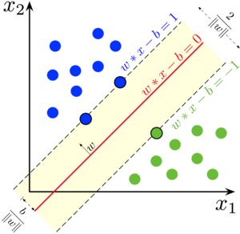
A Clinical Data Science Workflow
Pose a research question
Identify data sources
Create Analysis ready dataset
Analyze data, and conclude
Evaluate and redesign
Understand literature
Understand what the pressing questions are
Understand the healthcare system and where data come from
Programming, and manipulating different types of data
Statistics, Machine learning, and being able to do the right analysis for the research question
Notes:
EACH of these steps is important. The last one is what draws the most focus and interest, but even the best analysis can’t salvage unclear research aims, inappropriate data, and bad feature engineering.
We will teach all of these. Most classes will only teach you the last part.

Slide 7
Learning Goals
1
Differentiate between and give examples of categories of research questions and the study designs used to address them
2
Describe common healthcare data sources and their relative advantages and limitations
3
Extract and transform various kinds of clinical data to create analysis-ready datasets
4
Design and execute an analysis based on your familiarity with the workings, applicability, and limitations of common statistical methods
Leverage your knowledge of 1-4 to evaluate and critique published research
5

Slide 8
Course organization
Healthcare System and Research Questions
L: 1, 2
What is the healthcare system and how does it function?
What are the different kinds of research questions?
Understanding Data Sources
L: 3, 4
Where do data arise in the healthcare system?
What problems might the different data types have?
Building Datasets
L: 5,6,7,8,9,10
How do we transform unstructured data into analysis ready datasets
How can we use prior knowledge to build better datasets?
Drawing Conclusions
L: 11 -- 20
How do we pick the right statistical method for our question?
What are the common errors, and how can we avoid being wrong?

Slide 9
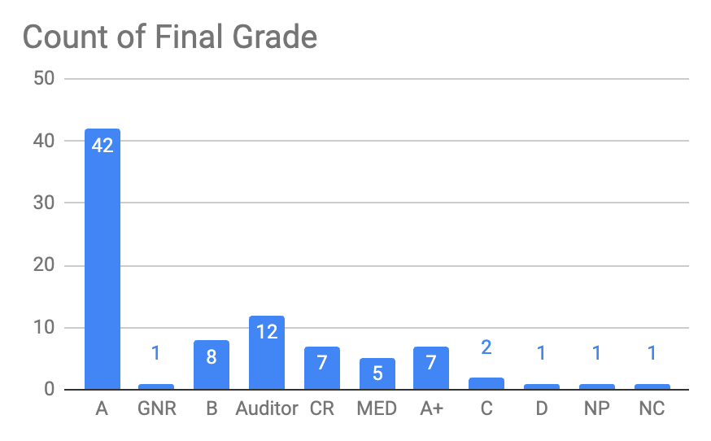
Grading, DUAs, HW and honor code
Activity | Name | Points
Participation |  | 100
Paper critique |  | 200
Hands on Ex. |  | 100
HW1 | Clinical questions and analyses | 100
HW2 | Data sources and biases | 100
HW3 | Cohort building | 80
HW4 | Feature engineering | 120
HW5 | Associative analysis | 100
HW6 | Predictive and causal analyses | 100
 | Total | 1000
Grade | Percentage
A | 92%–100%
B | 83%–91%
C | 74%–82%
D | 65%–73%
E / F | 64% and below
No midterm, No final
Late days: 3 days, 20% off per day

Slide 10
Why do we do these things?
Category | Definition | Example
Evaluation | Judgment, making value decisions about issues | Is the personal health record the best option to unify health records across providers in the US?
Synthesis | Combining ideas, creating an original product | Design a study to determine the best blood-pressure-lowering drug
Analysis | Subdividing into component parts, determining motives | Contrast the use of linear and nonlinear predictive models for hospital readmissions
Application | Problem solving, applying information | Build a patient-feature matrix to represent this cohort
Comprehension | Interpreting, paraphrasing | What is the difference between logistic and linear regression?
Knowledge | Memorizing, recalling information | List common types of patient data
Paper
critique
Complexity
Homework
Lectures
Notes:
see: https://en.wikipedia.org/wiki/Bloom%27s_taxonomy

Slide 11
Hold us Accountable!
If you haven’t learned these things by the end of the course, and you feel like you put in a solid effort, write about it in the course review!
We want to know what we’re doing right and what we can do better.

Slide 12
The syllabus is your friend
Always go to the syllabus first
E.g. “Getting up to speed”.
R: R for Data Science
Stats: Stanford Online Statistics in Medicine
ML: Stanford Online Intro to Statistical Learning
If you can’t find something in the syllabus, please let us know so we can fix it.
http://biomedin215.stanford.edu

Slide 13
MIMIC DUAs – message from MIT staff
“I simply don't have time to send students messages pointing out obvious errors. If they can't proofread, they can't be trusted with possible PHI. Sorry...”
Part of the learning in this class, is to be diligent enough that people give you data.

Slide 14
Action items
Make sure to have Canvas access
Send us a 2-3 line description of yourself, and why are you taking this class.
HCP students: Contact Sohaib Hassan if you are stuck.
Check Canvas regularly
discussions, announcements, HW
Fill out the post lecture surveys
Notes:
Share WHY we have post lecture surveys.

Slide 15
BIOMEDIN 215 Data Science in Medicine
Nigam Shah, MBBS, PhD
nigam@stanford.edu

Slide 16
Let’s meet Laura
A teenager with systemic lupus erythematosus, proteinuria, pancreatitis and positive for antiphospholipid antibodies
www.webmd.com/lupus/picture-of-acute-systemic-lupus-erythematosus
Notes:
We need to manage the acute situation, as well as manage her risk for outcomes like thrombosis, which is increased given her presentation with proteinuria, antiphospholipid antibodies and pancreatitis.

Slide 17
Let’s meet Vera
A 70 year old Asian woman with a history of hypertension and asthma. She is on metformin but has uncontrolled diabetes.
Getty Images
Notes:
We need to manage the acute situation, as well as manage risk for chronic diseases such as heart attack, stroke, renal failure, and osteoporosis.

Slide 18
A timeline view of patient data
Let’s draw a patient timeline
Notes:
Call randomly on students to build this map

Slide 19
Thinking of data in terms of a timeline
Take proactive action
Patient Journey
Claims
ICD codes
Medications
Procedures
Lab tests
Clinical notes
Bedside monitors
Wearables
Gene Expression
Phone usage
Automate a tedious task
Browsing history
Social media
Audio recordings
:
Notes:
Typically, “data” are thought of as residing in tables, text files, images, etc. However one of the most useful viewpoints to have is that of a patient timeline. Healthcare happens over time and it is immensely useful to think of data in those terms--as events occurring over time.
On screen is a patient journey, with the red dots denoting an event with some healthcare relevance. Depending on the access point into medical data, we’d get a partial view of the event that really occurred. For example, we might get some claims filing corresponding to a visit, which might have ICD codes, medication codes, CPT codes, and laboratory test orders. In the EHR, we might get the results of the tests, have access to the clinicians notes, perhaps to the signal streams from bedside monitors and more.
Outside of the health system, we might get data from wearables such as a fitbit or an apple watch (and increasingly such devices are now tethered to the healthcare system as well). In a research setting we might find gene expression data, genomic data, and perhaps more kinds of molecular measurements.
Further out from “medical care” we get to the digital exhaust of our online activities -- phone usage, browsing, social media postings, audio clips and so on. The slide only shows the few types of data that I have worked with directly. We can imagine perhaps 50-60 such “tracks” of information that are collected by different entities in the healthcare ecosystem -- which we will get to on the next slide.
Using these data, “AI” or “machine learning” is used to do two things:
Automate a tedious task
Combine multiple data modalities to trigger some proactive action
Automating a tedious task tends to be the dominant category of effort, whereas the combining data modalities tend to be the more innovative category of efforts.

Slide 20
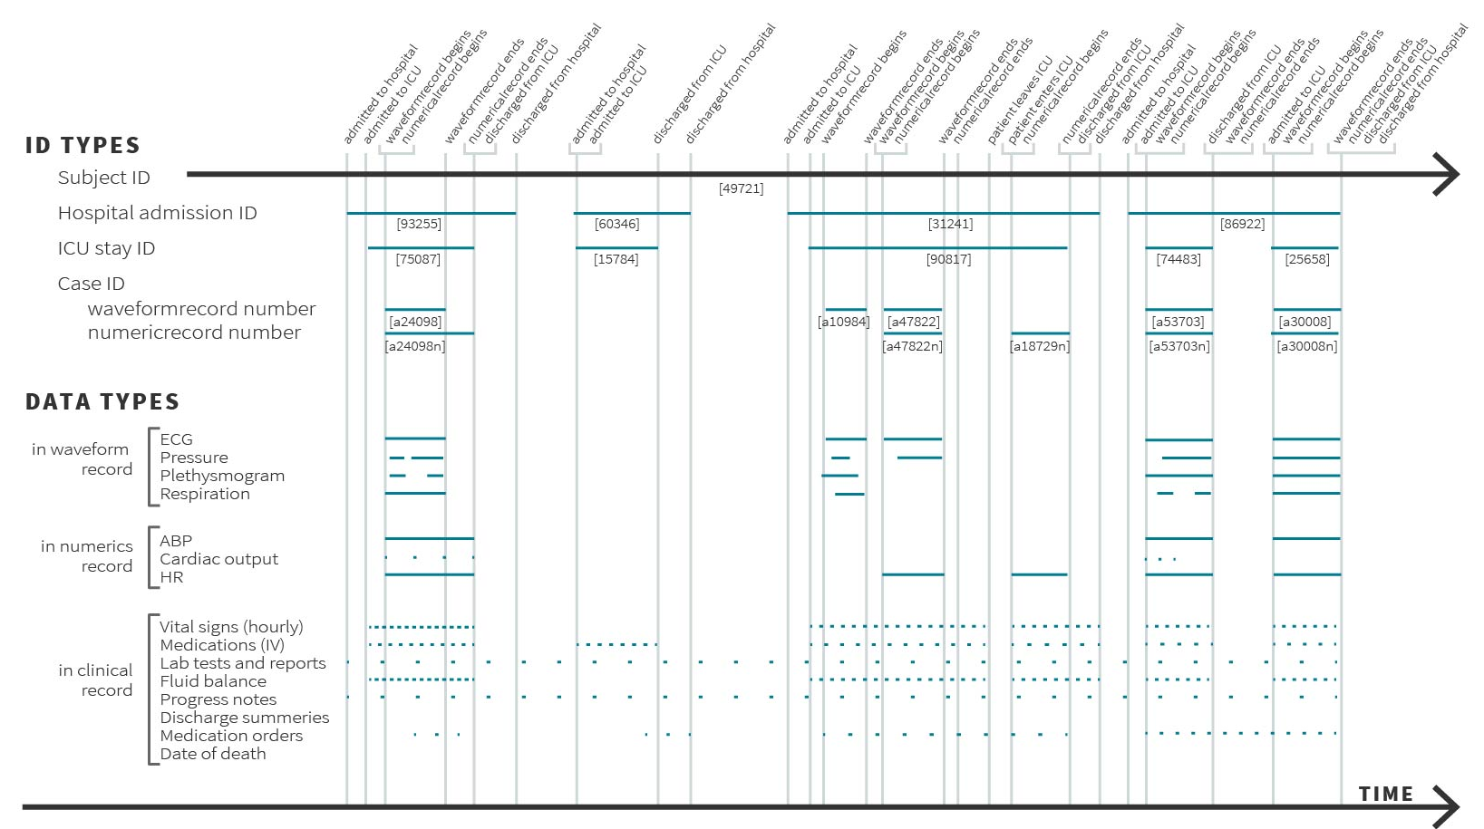
A timeline from the MIMIC dataset

Slide 21
Decide whether to act
If (Risk > Th.)
then (do = X)
Guide choice of how to act
Notes:
These two examples are the kinds of decisions that form the core of clinical care. I jokingly refer to the construct on screen as the “equation of medicine”. In any given situation, a clinician has to assess multiple such risk-equations, and if the risks are above a certain threshold (which is often left undefined) then take the appropriate actions.
The way machine learning can help is by solving a risk stratification problem which aids the decision of whether to act (think Laura) or by solving a treatment recommendation problem which aids the decision of how to act (think Vera).

Slide 22
Whose problem are you solving?
Science
Practice
Delivery
Classify
Finding subtypes of heart failure with preserved ejection fraction
Who might be at high risk for a thromboembolism?
…
Predict
Increased Monocyte Count is marker for bad prognosis in fibrotic diseases
…
Who will be a no show?
Recommend
…
What is a good second line drug to manage diabetes after metformin?
…
Notes:
.

Slide 23
Healthcare in the United States
Who are the key players, what are their roles, and what are their interests?
How, where and why, are data produced?
What are the opportunities?
Notes:
Meaningful use = 3 parts
MU-1, get an EMR
MU-2, use the EMR for random bunch of things
MU-3, change outcomes by using the EMR.
Affordable care act:
everyone buys insurance
for a patient you accept, keep them healthy, happy and alive
Need to emphasize that data is fragmented across multiple sources, each of which have problems

Slide 24
Breakout: Anatomy of the US Healthcare System
In the next few minutes, work in your breakout group to create a “concept map” of the US healthcare system as you understand it.
Include what you identify as the key players and how they interact.
Notes:
Keeping people “healthy”
Minimizing the ill effects of being “unhealthy”

Slide 25











Health Care Overview
GOVERNMENT
Hospital/Clinic/Doctors
Insurance
Drug Store
Individual or Family/Support Network (Patient/Consumer)
Pharma/Biotech
(Medical Devices, Diagnostics)
Internet
Library/Journals
Vendors
(Software/Web/Portals/ Instrumentation/Hardware
CROS)
Notes:
Healthcare overview (patient centered view of healthcare)
Latest numbers of healthcare costs (paper)

Slide 26
Breakout: Anatomy of the US Healthcare System
In the breakout group, work with your colleagues to answer the following question:
What are the kinds of data that each of these entities generate? For what purpose?
Example: individual patients generate fitness tracker data for their own personal interest

Slide 27
Where and why are data generated?
GOVERNMENT
Census and demographics
Epidemiological data
Economic data
Health records
Doctors notes
Queries
Business intelligence
billing
Public Policy making
Operations
Quality
Billing
claims
Hospital/Clinic/Doctors
Insurance
Drug Store
Fitness trackers
Home monitors
Forums
Domain knowledge
Personal interest
Caregiver records
Marketing
Business intelligence
Individual or Family/Support Network (Patient/Consumer)
Pharma/Biotech
(Medical Devices, Diagnostics)
Sales
Domain knowledge
Public databases
Operations
Marketing
Internet
Library/Journals
Vendors
(Software/Web/Portals/ Instrumentation/Hardware
CROS)
Public use
Professional gain

Slide 28
Finding problems worth solving

Slide 29
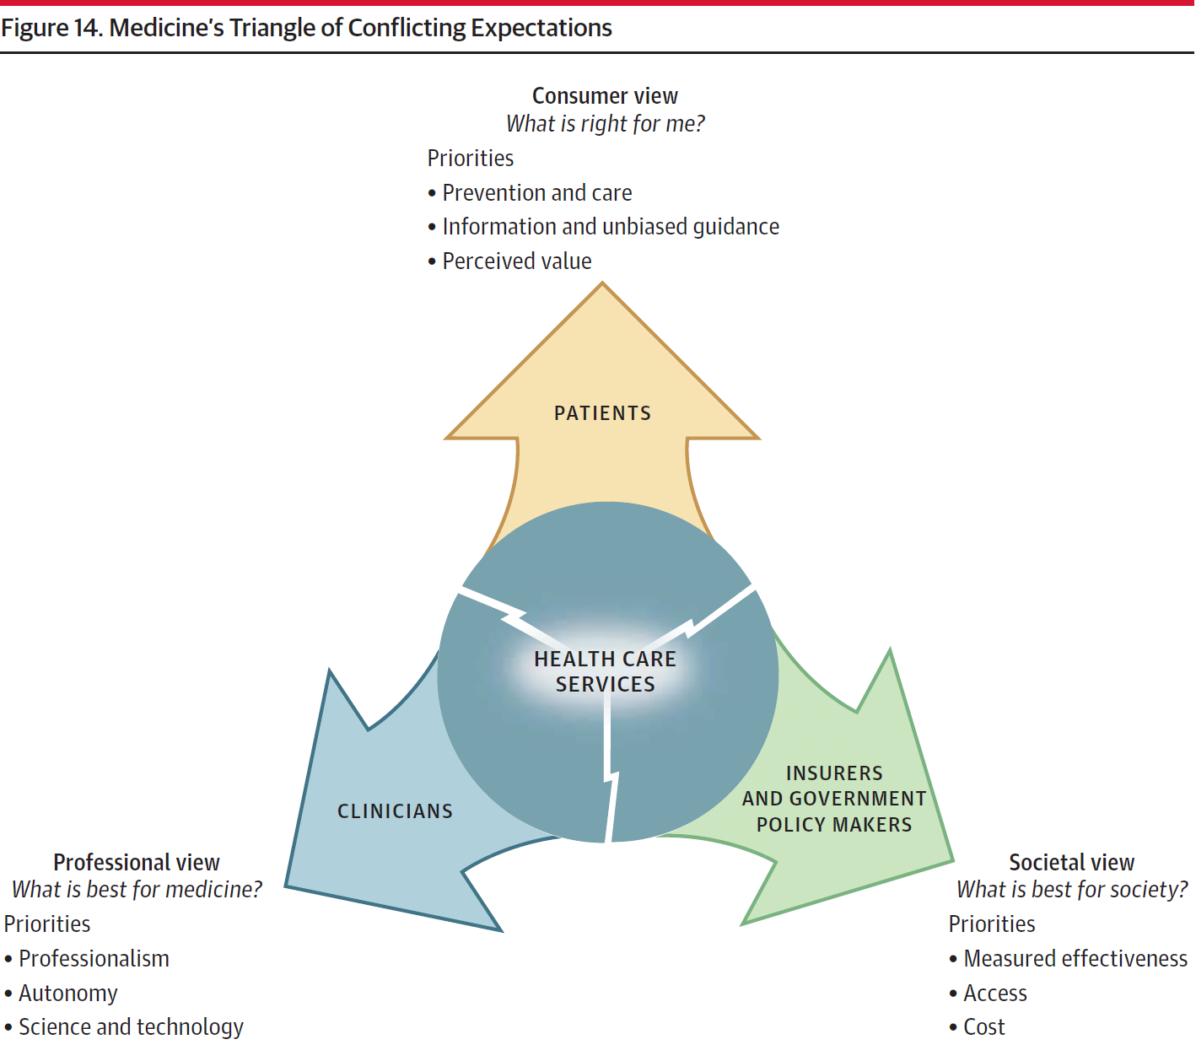
Healthcare in the United States
Notes:
What is the system for?
Who are the key players, what are their roles, and what are their interests?
How does the system function economically?
What are the trends, failures, and opportunities?
How, where and why, are data produced?

Slide 30
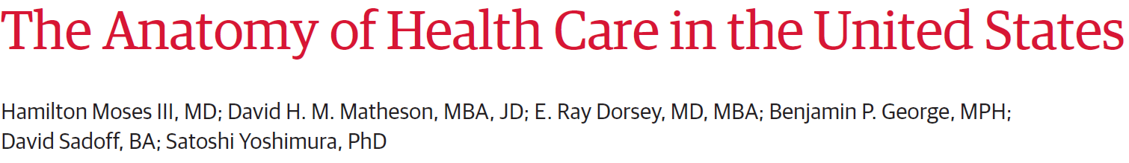
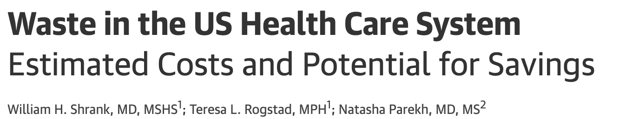
Publicly available data from 1980 to 2011, on the source and use of funds.
Review of 54 publications focused on 6 waste domains identified by IOM
Follow the money and the disease burden … it will lead you to the problems that really need to be solved
Notes:
The findings from this analysis contradict several common assumptions. Since 2000,
price (especially of hospital charges [+4.2%/y], professional services [3.6%/y], drugs and devices [+4.0%/y], and administrative costs [+5.6%/y]), not demand for services or aging of the population, produced 91%of cost increases;
personal out-of-pocket spending on insurance premiums and co-payments have declined from 23%to 11%;
chronic illnesses account for 84%of costs overall among the entire population, not only of the elderly.
Three factors have produced the most change:
(1) consolidation, with fewer general hospitals and more single-specialty hospitals and physician groups, producing financial concentration in health systems, insurers, pharmacies, and benefit managers;
(2) information technology, in which investment has occurred but value is elusive;
(3) the patient as consumer, whereby influence is sought outside traditional channels, using social media, informal networks, new public sources of information, and self-management software.

Slide 31
Let’s put it all together

Slide 32
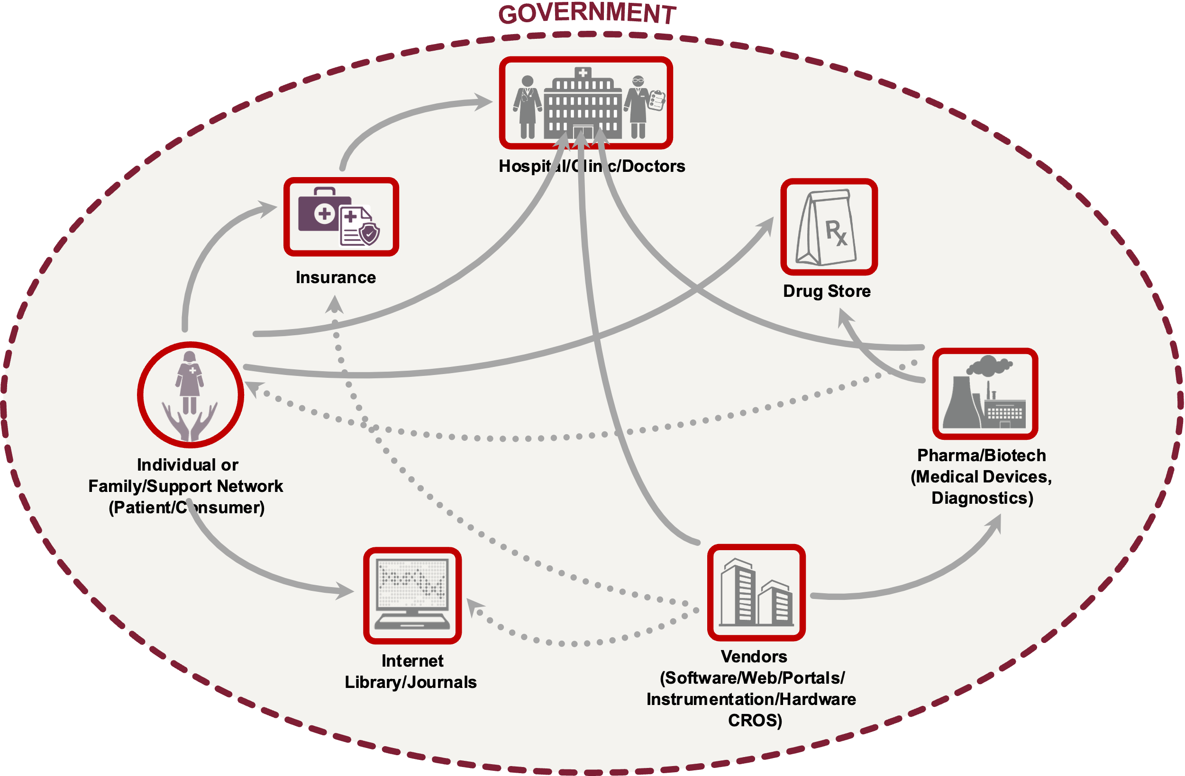
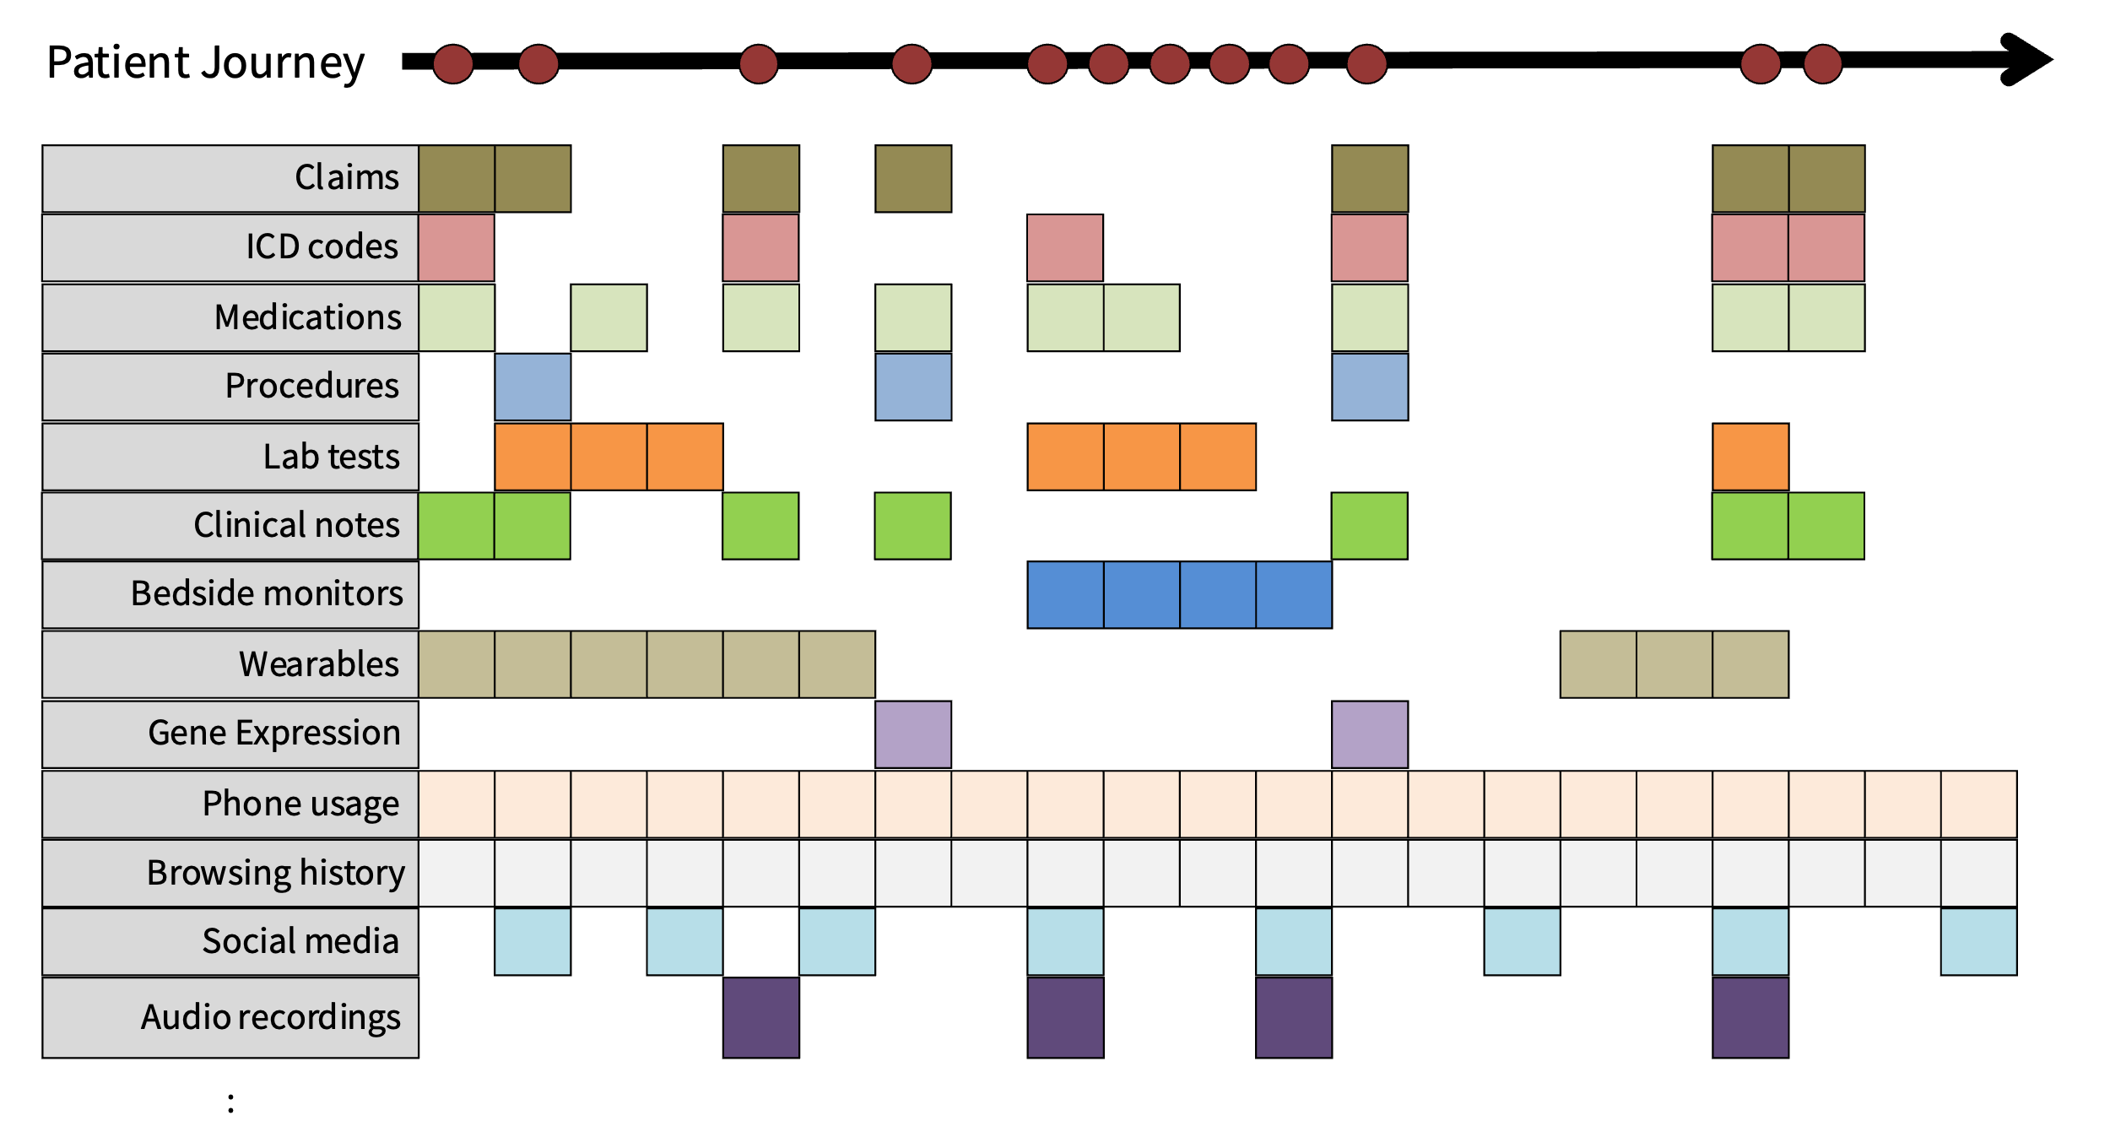
Key concepts in our mind map
The basics:
The anatomy of the healthcare system
The research questions and study designs
The sources of, and errors in, the data used
Using knowledge graph/s of things, and relationships
The choices:
The source and choice of features
How much to agonize over textual data
On the handling of time
In defining an electronic phenotype
Notes:
Attention to where and why are data generated
Adopting a patient timeline view of the data
Creating a patient-feature-matrix, requires decisions about:
the source and choice of features
how much to agonize over unstructured data
the handling of time
the definition of an electronic phenotype
The part of the “equation of medicine” that is being helped
A grid of what ML does X what is advanced

Slide 33
Suggested reading
Stephen Blyth
Big Data and Machine Learning Won’t Save Us
Harvard Business review, September 18th 2018
Moses H, Matheson DHM, Dorsey ER, George BP, Sadoff D, Yoshimura S.
The Anatomy of Health Care in the United States.
JAMA. 2013;310(18):1947–1964. doi:10.1001/jama.2013.281425
Watch “Overview of Health Care Systems and Key Challenges They Face”
Notes:
https://www.coursera.org/learn/intro-to-healthcare?specialization=ai-healthcare#syllabus
Watch - Overview of Health Care Systems and Key Challenges They Face

